Slide 1
Crowdfunding Project
Mentor Name:
Miss Dipti Sinha
Presented by:
1. Priti Warungase
2. Umesh Garg
3. P. Gnana Prakash
4. Mohith Naga Sai Kadavakollu

Slide 2


Index
Describe Crowdfunding
1.Excel-Slide No-11
2.Sql- Slide No-12
3. Tableau-Slide no-13
4.Powerbi-slide no-14

Slide 3
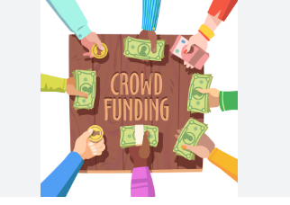
Introduction of Crowdfunding
Crowdfunding means collecting small amount of money from many people to fund a project.
Crowdfunding is a form of crowdsourcing and alternative finance. In 2015,over US$34 billion was raised worldwide by crowdfunding.
Top crowdfunding platform:- Crowdfunding websites such as KICKSTARTER,INDIEGOGO, GOFUNDME

Slide 4
Tools & Techniques
1.excel:- Data cleaning ,summary statistics , pivot table.
2.Sql:-Data extraction , aggregation queries
3. Power BI:- Interactive Dashboard creation and visualization.
4. Tableau:- Dashboard creation, and visualization

Slide 5
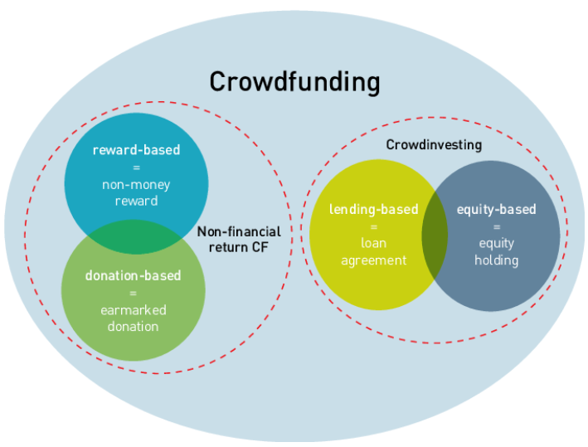
Crowdfunding Models

Slide 6
Project Overview KPI
1. Total number of project based on Outcome
2. Total number of project based on Location
3. Total number of project based on Category
4. Total number of project created by Year, Quarter, Month

Slide 7
Successful projects
Amount Raised
Number of Backers
Avg number of days for successful projects
Top successful project
1.Based on number of backers
2.Based on Amount Raised
Percentage of successful project overall
Percentage of successful project by category
Percentage of successful project by Year, Month etc.
Percentage of successful project by Goal Range

Slide 8
Cleaning Dataset using Power Query
What is power query?
Power query is used for gathering and cleaning data.
It is tool which is used for cleaning your dataset.
It remove the repetitive records, duplicates value, and Null value.

Slide 9
Data Modeling
Data modeling is used to build the model using power pivot
Power pivot:-
Power pivot it is used to establish connection between two or more tables with the help of common column.

Slide 10
Application of Crowdfunding
Crowdfunding is used in many sector to raise money ,test, ideas, and support causes.
Real word application are follows:-
Business and start-up funding
Creative and Entertainment projects
Social and charity causes
Research & Innovation
Product pre order &Marketing
Environmental projects

Slide 11
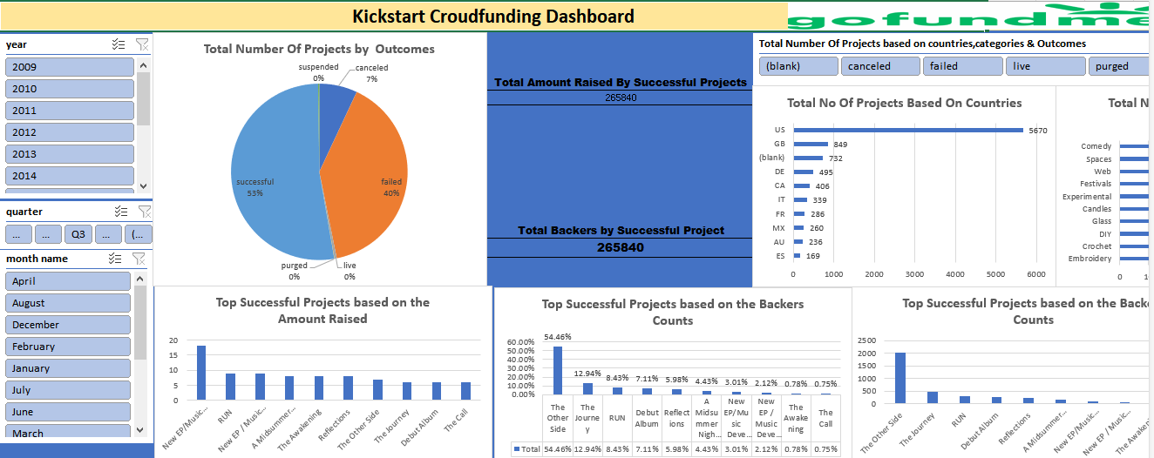
EXCEL CROWDFUNDING DASHBOARD

Slide 12
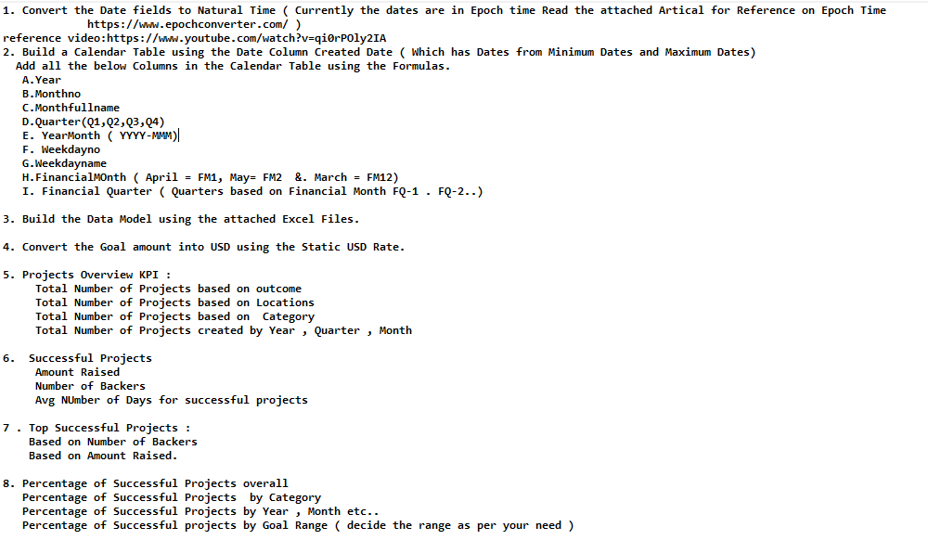
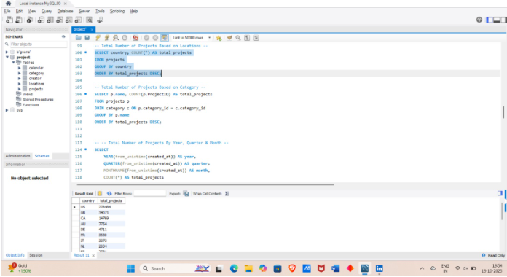
Crowdfunding Sql Queries

Slide 13
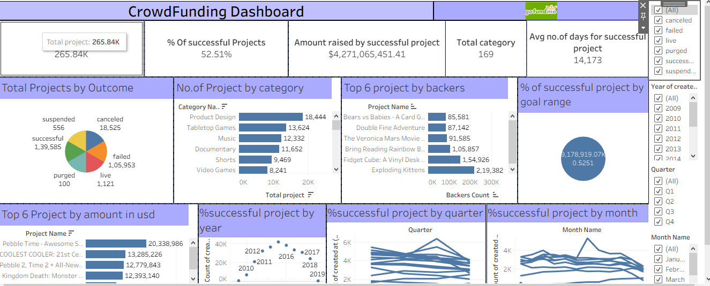
Tableau Crowdfunding Dashboard

Slide 14
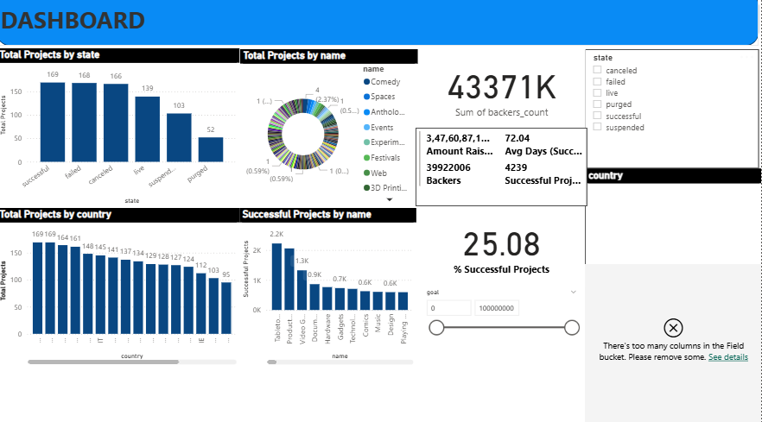
Power Bi Crowdfunding Dashboard

Slide 15
Conclusion
1.Crowdfunding success depends on Goal Amount, Category and Campaign duration.
2. Data visualization helped uncover success trends.
3. Crowdfunding is a Low-risk, high reward method of acquiring capital for start-up.

Slide 16


